Slide 1
.NET & IDE

Slide 2
.NET Introduction
.NET is a free, cross-platform, open-source developer platform for building many kinds of applications.
It can run programs written in multiple languages, with C# being the most popular.

Slide 3
.NET Components
.NET includes the following components.
Runtime -- executes application code.
Libraries -- provides utility functionality like JSON parsing.
Compiler -- compiles C# (and other languages) source code into (runtime) executable code.
SDK and other tools -- enable building and monitoring apps with modern workflows.
App stacks -- like ASP.NET Core and Windows Forms, that enable writing apps.

Slide 4
.NET Ecosystem
There are multiple variants of .NET, each supporting a different type of app. The reason for multiple variants is part historical, part technical.
.NET Framework -- The original .NET. It provides access to the broad capabilities of Windows and Windows Server. It is actively supported, in maintenance.
Mono -- The original community and open-source .NET. A cross-platform implementation of .NET Framework. Actively supported for Android, iOS, and WebAssembly.
.NET (Core) -- Modern .NET. A cross-platform and open-source implementation of .NET, rethought for the cloud age while remaining significantly compatible with .NET Framework. Actively supported for Linux, macOS, and Windows.

Slide 5
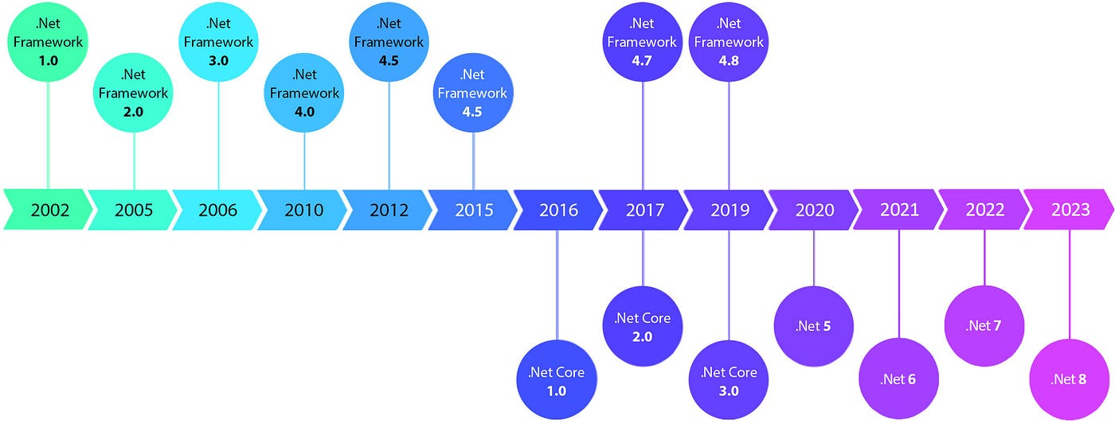
.NET HISTORY

Slide 6
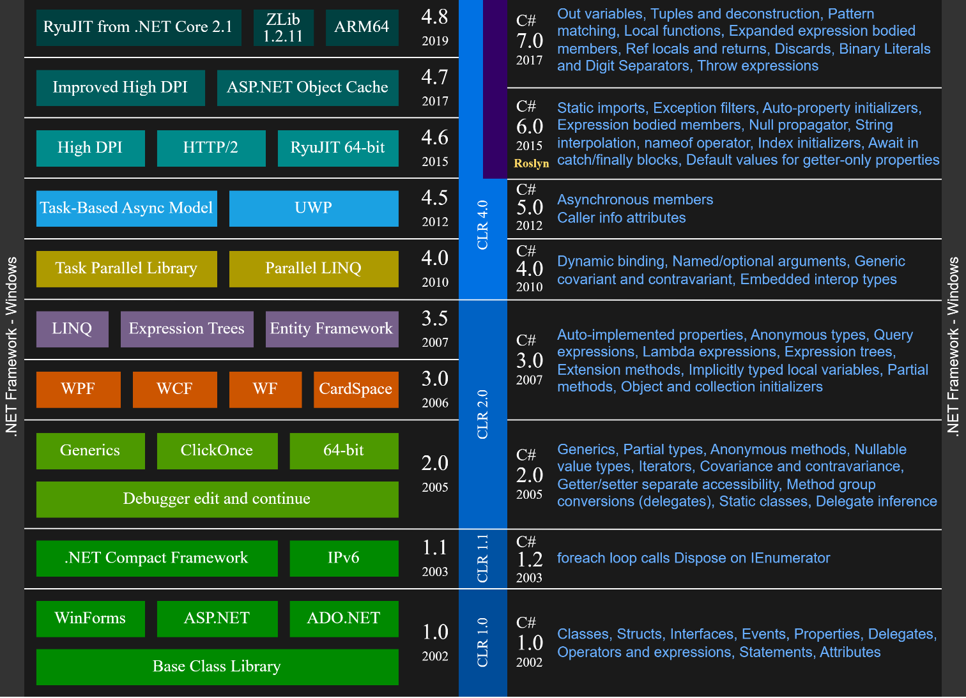

Slide 7
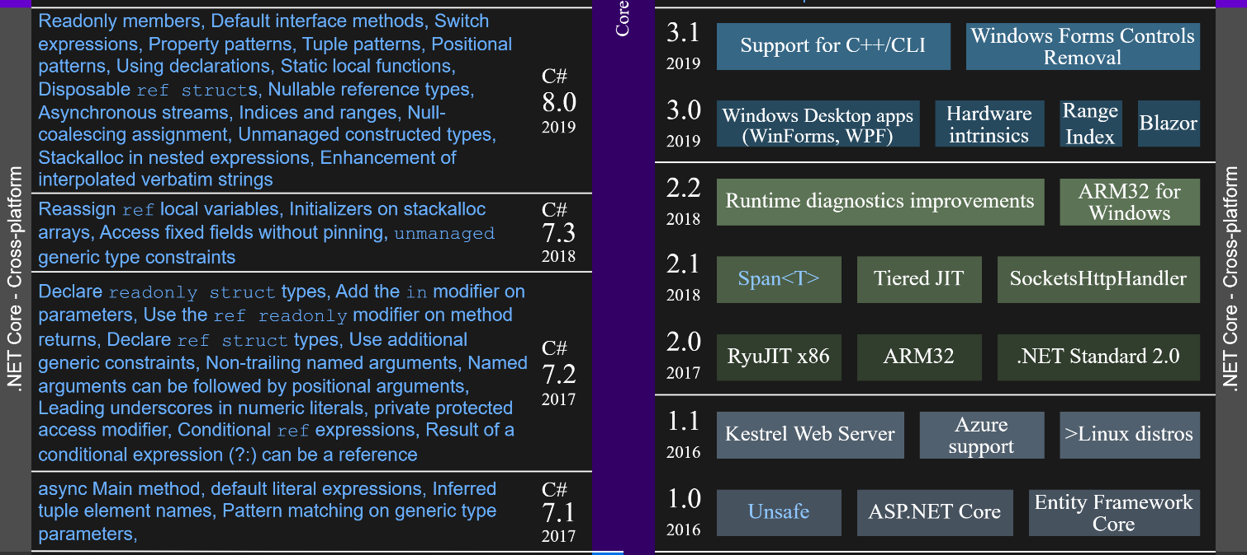

Slide 8


Slide 9
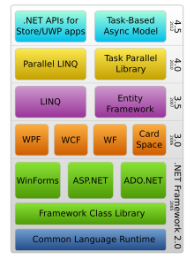
.NET Framework

Slide 10

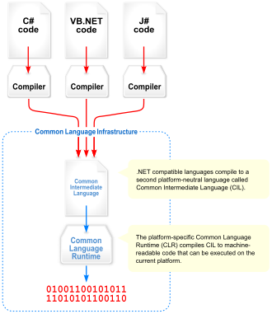



.NET

Slide 11
IDEs

Slide 12
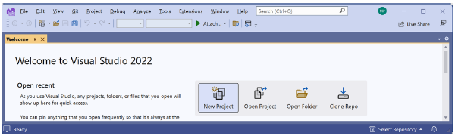
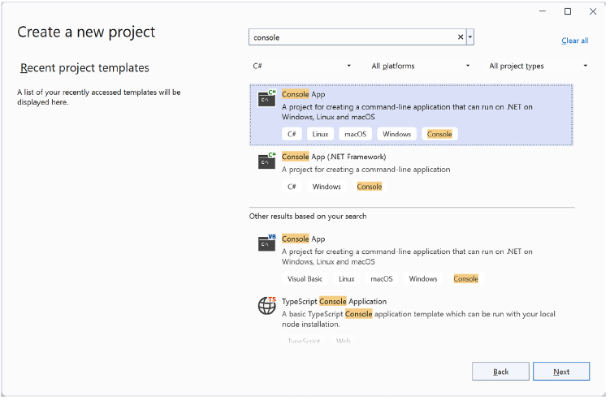
Visual Studio 2022

Slide 13
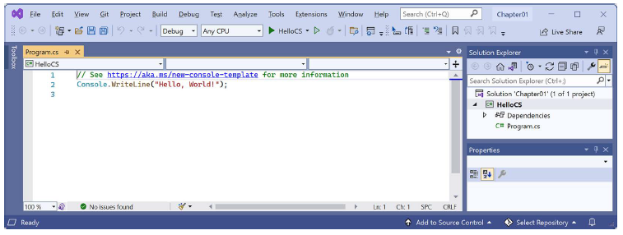
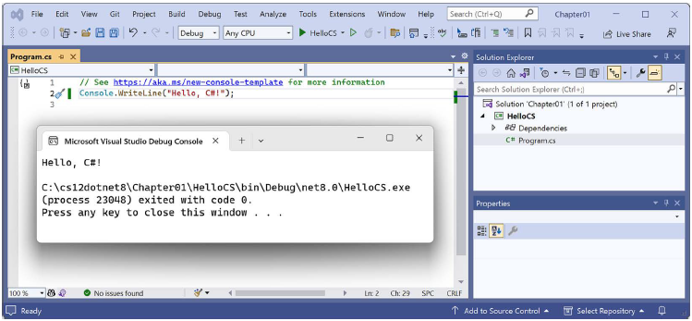
Visual Studio 2022

Slide 14
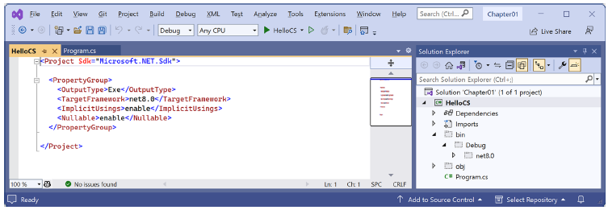
Visual Studio 2022

Slide 15
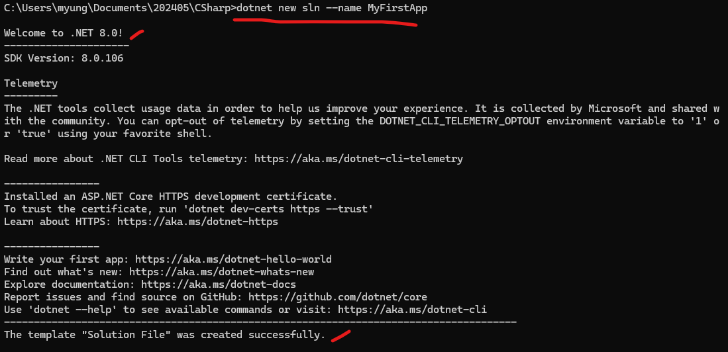
Visual Studio Code and .NET CLI
Using Command Prompt / Terminal
Create a new solution named MyFirstApp
dotnet new sln --name MyFirstApp

Slide 16
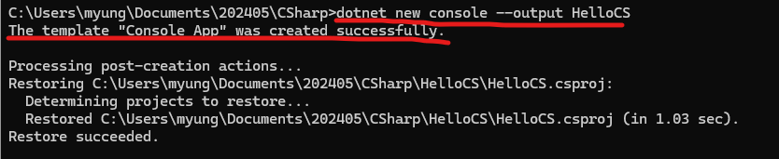
Visual Studio Code and .NET CLI
Create a new subfolder and project for a console app named HelloCS
dotnet new console --output HelloCS

Slide 17
Visual Studio Code and .NET CLI
Add the project to the solution
dotnet sln add HelloCS

Slide 18
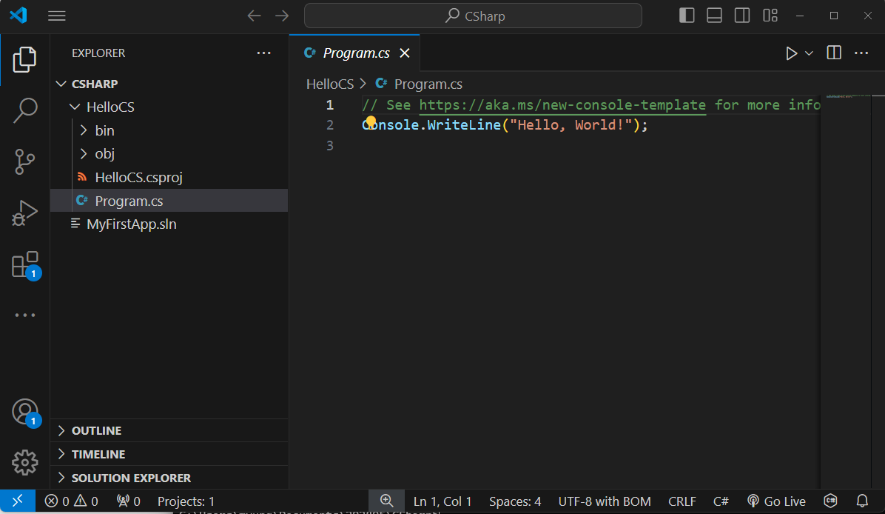
Visual Studio Code and .NET CLI
Start Visual Studio Code
code .

Slide 19
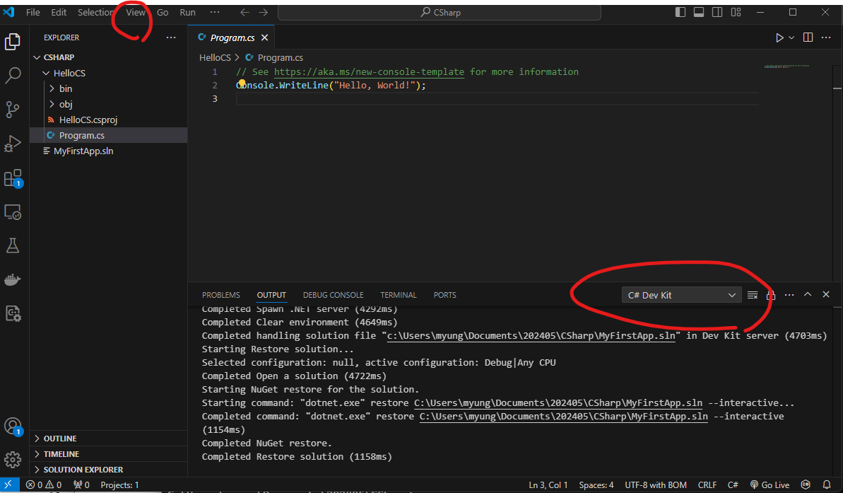
Navigate to View | Output.
In the OUTPUT pane, select C# Dev Kit.

Slide 20
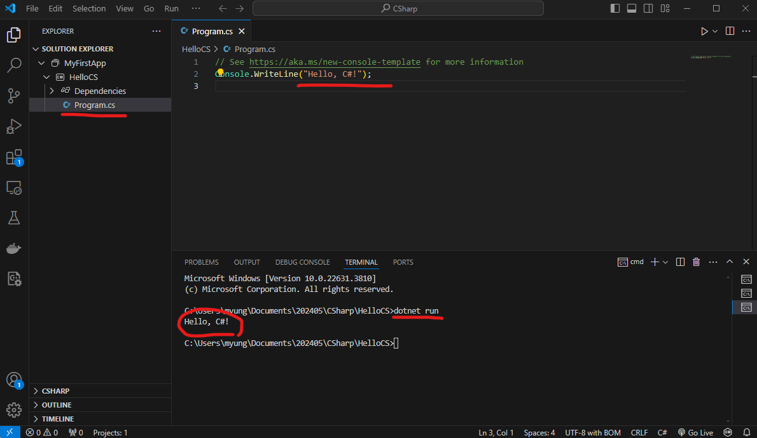
Right-click on any file in the HelloCS project and choose Open In Integrated Terminal.
In TERMINAL, enter the command: dotnet run.

Slide 21
Add a new project
In Terminal, change to the upper directory
cd ..
In Terminal, enter the command to create a new console app project named AboutMyEnvironment using the older non-top-level program style
dotnet new console -o AboutMyEnvironment --use-program-main
In TERMINAL, use the dotnet CLI to add the new project folder to the solution
dotnet sln add AboutMyEnvironment

Slide 22
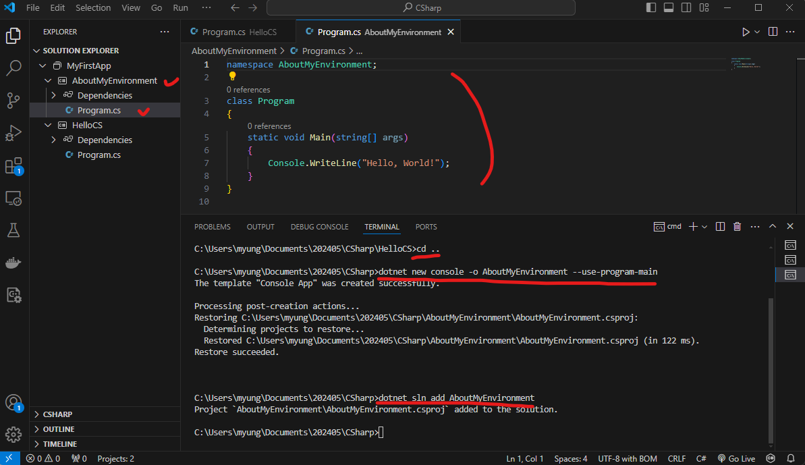

Slide 23
Modifying Program.cs of the new project
Open Program.cs using Solution Explorer and in the Main method, change the existing statement with the following code.
Console.WriteLine(Environment.CurrentDirectory);
Console.WriteLine(Environment.OSVersion.VersionString);
Console.WriteLine("Namespace: {0}", typeof(Program).Namespace);
In TERMINAL, run the project
dotnet run

Slide 24
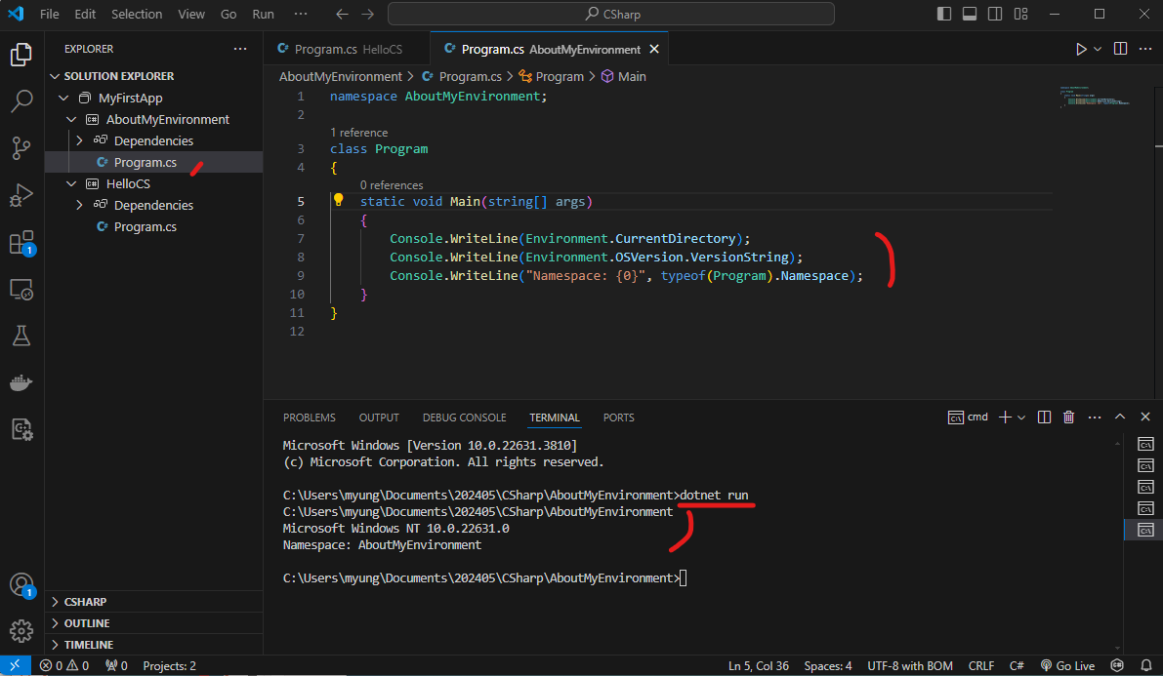

Slide 25
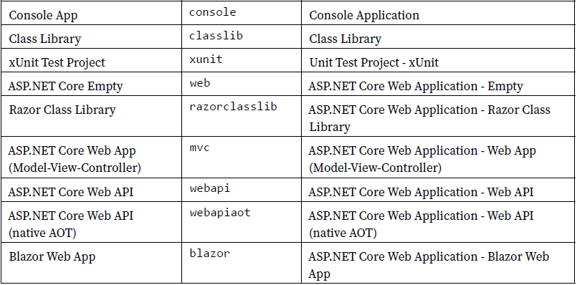
Project Types

